Slide 1
Fee Report(Java Application)
Test Report
Presented by-
Hossen MD. Abir 15-28434-1
Sarwar, Tausif 14-26927-2
Hasan Md. Ariful 15-29287-1
Sarker Niloy 15-28805-1
Eiaser 14-27170-2

Slide 2
Contents
Purpose
Unit Testing
System Testing
User Acceptance Testing
Regression Testing

Slide 3
Purpose
The report provide with the summary of the test performed on Fee Report program
Project Name: Fee Report
System Name: Java
Additional Comment: Unit testing, System Testing, Acceptance testing, Regression testing was done by the testers

Slide 4
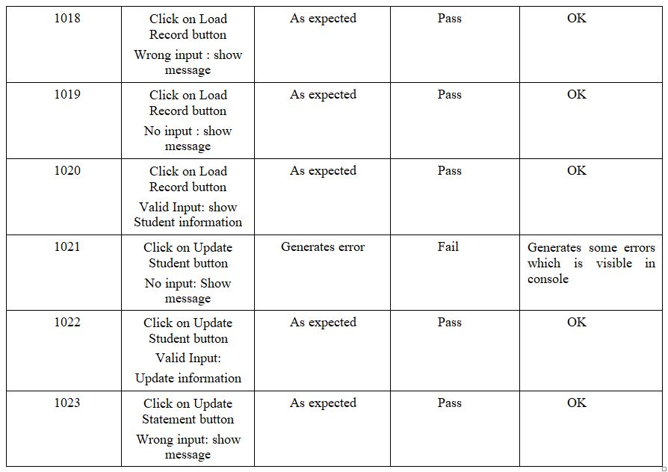
Unit Testing
Unit Testing was done at first
Each class was treated as a module

Slide 5
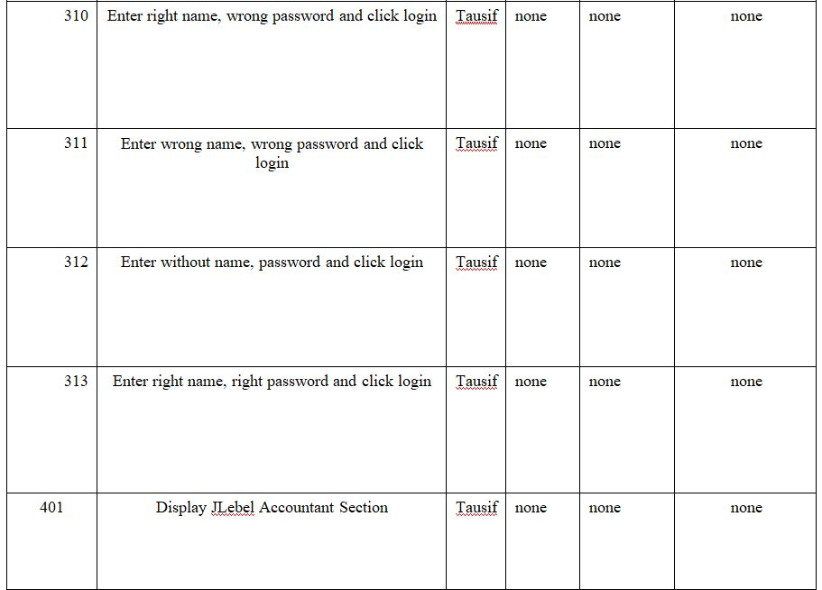
System Testing
System testing was done on the program
The whole program was treated as a system when undergoing this test

Slide 6
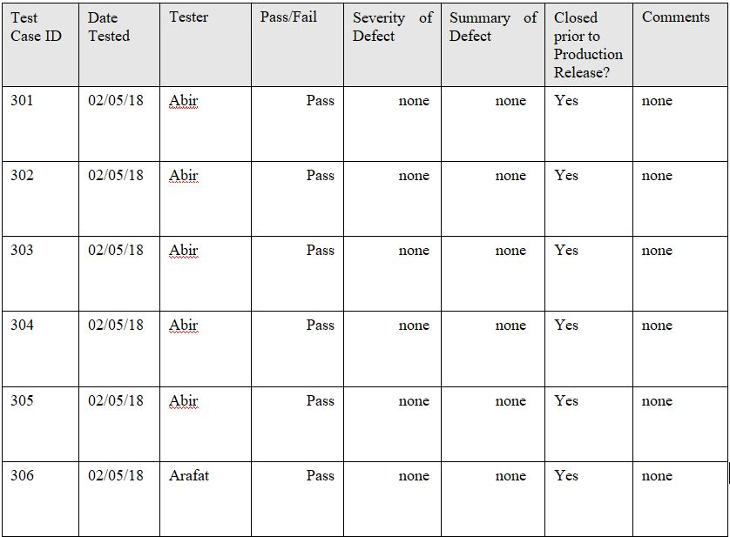
User Acceptance Testing
User Acceptance testing was done by the testers because of short time

Slide 7
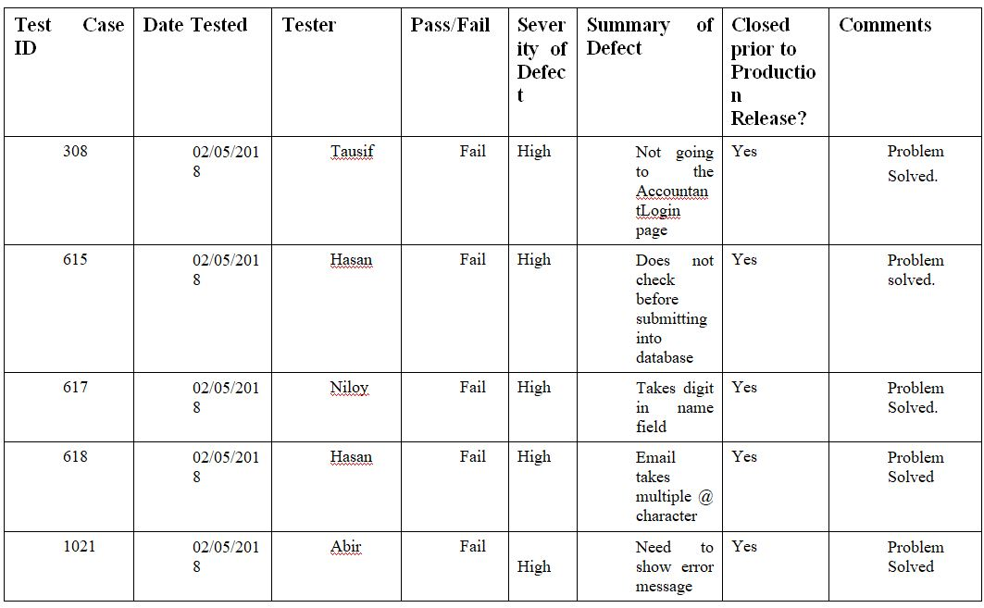
Regression Testing
We have fixed some problems that appeared during test process

Slide 8
Thank you☺

